Slide 1
Wave & Resonance
Jun Ki Chae
Notes:
Introduce myself

Slide 2
So What is wave?
Notes:
Ask them what they remember, some properties, types
Get them to think about it.

Slide 3
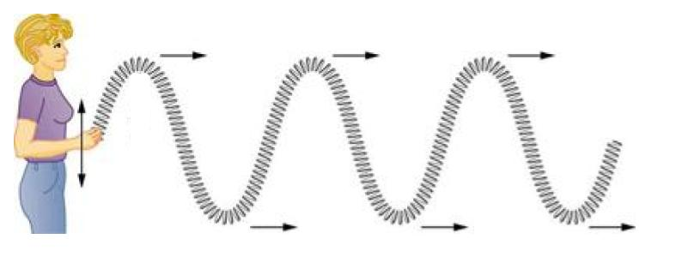
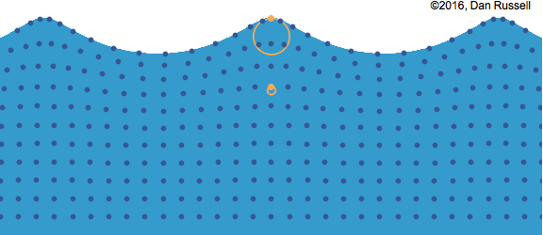
What is Wave?
Is a disturbance traveling through medium
The particles themselves do not move along the wave
https://www.khanacademy.org/science/high-school-physics/waves-and-sound/introduction-to-waves/a/transverse-and-longitudinal-waves-ap1
https://www.acs.psu.edu/drussell/Demos/waves/wavemotion.html
Notes:
Wave is a disturbance that travels through medium from one location to another carrying energy.
Particles themselves do not move away from its position:
Ex) Talk about floating in water (wave), They just float their in circular motion
Ex) Talk about sound wave, they fact they can hear you live means air molecule is pushing energy

Slide 4
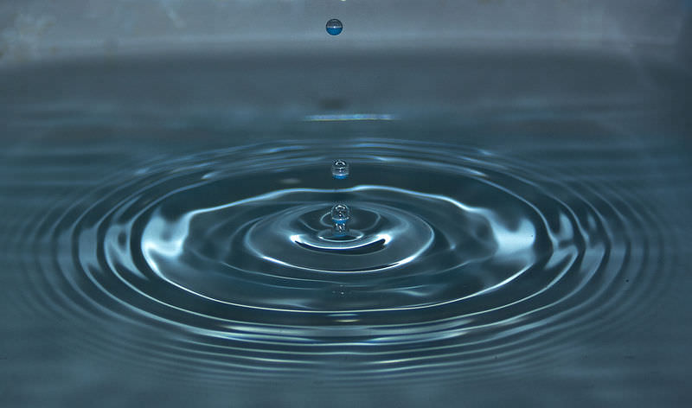
Type of Waves
Mechanical Wave
Move through matter
Electromagnetic Wave
Move through vacuum
https://www.ck12.org/c/physical-science/mechanical-wave/lesson/Mechanical-Wave-MS-PS/
http://www.blackwelleyesight.com/sunglasses-comfort-protection/

Slide 5
Transverse Wave
Longitudinal Wave
Particle move parallel to the direction
Particle move perpendicular to the direction
https://tisayyu.wordpress.com/2018/10/13/waves-of-existence/
Notes:
Pay attention to the direction of motion of the particles

Slide 6
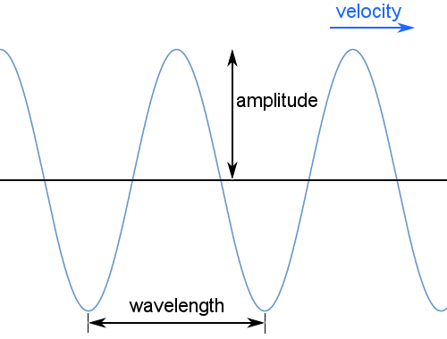
Wave Properties
Amplitude: maximum distance moved by a point
Wavelength: Distance in which wave shape repeats.
Frequency: how many wave length per unit time
Period: time for one wavelength
https://www.chemicool.com/definition/wave.html
Notes:
Although this looks like it only apply to transverse wave, it does not have to.
Ex) Next slide: sound wave

Slide 7
Sound Wave
Longitudinal mechanical wave
Generated by vibrating object
Travels at 343m/s at room temperature
https://www.ccohs.ca/oshanswers/phys_agents/noise_basic.html
Notes:
Example of longitudinal wave described in sinusoidal wave.

Slide 8
Refraction Diffraction Reflection
http://scienceres-edcp-educ.sites.olt.ubc.ca/files/2015/01/sec_phys_optics_refraction.pdf
https://www.pinterest.es/pin/642466703085454334/
https://www.acs.psu.edu/drussell/Demos/reflect/reflect.htm

Slide 9
So what would happen if 2 waves in opposite direction meet?
https://www.pinterest.ca/pin/66850375694043643/

Slide 10
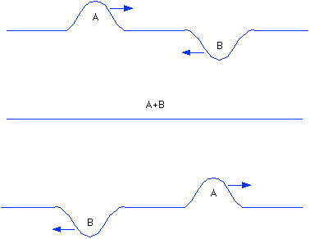
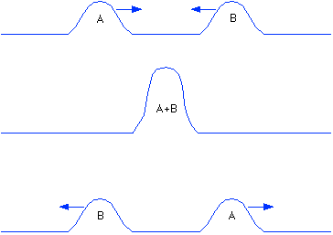
Interference
Destructive Interference
Constructive Interference
http://physics.bu.edu/~duffy/py105/WaveInterference.html

Slide 11
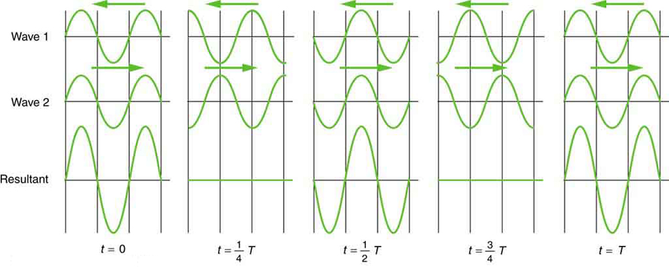
https://courses.lumenlearning.com/physics/chapter/16-10-superposition-and-interference/
Principle of Superposition
When two or more waves cross at point, the displacement at that point is equal to the sum of the displacement of the individual waves.
Notes:
And this make sense because if I and any of other students talk at the same time others can still hear both of the sounds because they can travel “though” each other.

Slide 12
So what would happen if 2 waves in opposite direction meet?
https://www.pinterest.ca/pin/66850375694043643/
Notes:
Animation of how two waves traveling in different direction create wave that seems to me standing still….
Creating (drum roll)…. (next slide)

Slide 13
Standing wave
Standing wave: wave which oscillates in time but peak does not change location.
Node: Point where the particle of the medium remain at rest
Anti-node (Loop) point where the particle suffer displacement
https://www.scienceabc.com/pure-sciences/standing-wave-definition-ratio-examples-and-explanation.html
Notes:
Standing wave!!!
Talk about some characteristics of standing wave, node/anti-node.

Slide 14
Ernst Chladni
German Physicist & Musician
Known as Father of
Acoustics
Meteoritic
https://en.wikipedia.org/wiki/Ernst_Chladni
Notes:
Ernst Chladni was German Born Hungarian physicist/ musician.
Known as father of acoustics because of invention of this experiment and calculating speed of sound through various gases
On the side note, he was the first one to publish idea of meteorites being extraterrestrial in origin which earned him the title of fater of meteoritic.

Slide 15
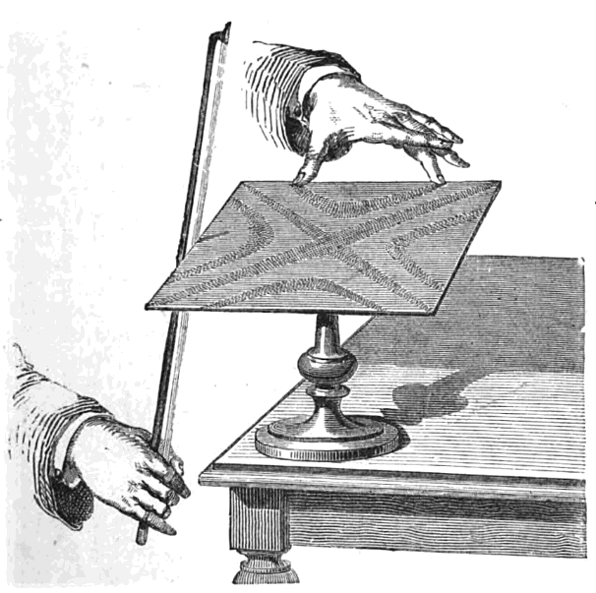
Chladni Plate
Resonance: phenomenon of increased amplitude that occurs when the frequency of a periodically applied force is equal or close to a natural frequency of the system on which it acts
Natural Frequency: frequency at which a system tends to oscillate in the absence of any driving or damping force.
https://en.wikipedia.org/wiki/Ernst_Chladni
Notes:
Talk about how simple it is to build this experiment and what Chladni was possibly thinking of making plate vibrate.
If he make plate vibrate there would be some frequency (natural frequency) that different materials like to vibrate at, meaning finding standing wave and this cause plate to resonate.
Galileo Galilei in 1602 who first discovered resonance, and about 150 yrs before Chladni

Slide 16
Notes:
If doing this live in front of students make sure the base is stable (not wobbly) and some what heavy or clamp the base of plate to it.

Slide 17
describe what happened
Resonance
Node /Nodal Line
Anti-Node
Frequency
Transverse wave
Reflection
Principle of Superposition
Notes:
Group activity to describe what happened in video with their own word before instructor go in depth

Slide 18
https://www.comsol.com/blogs/how-do-chladni-plates-make-it-possible-to-visualize-sound/
Notes:
Talk about 3 regions: nodal lines, area moving upward in this instant (red), area moving downward in this instant (blue)

Slide 19
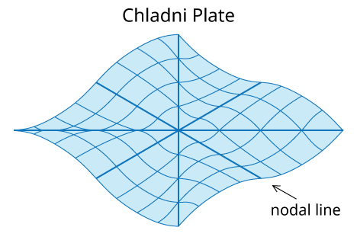
https://thinkzone.wlonk.com/StandingWaves/StandingWavesInChladniPlates.htm
Notes:
Exaggerated animation of plate in resonance.
Of course on the actual plate, the amplitude is still not see-able with bare eyes, so we use sand on top.

Slide 20
How would changing pitch of the sound change the patterns?
Notes:
Thought Experiment 1
Let students have small discussion before you answer (answer in 2 slides)

Slide 21
How would changing volume of the sound change the patterns?
Notes:
Thought experiment 2
Let students have small discussion before you answer (answer next slides)

Slide 22
Notes:
As the pitch gets higher the pattern become more complex because there are more points the reflected waves can interfere as wavelength gets shorter.
The volume only effects the amplitude so the sands might get pushed out at faster rate but barely noticeable.

Slide 23
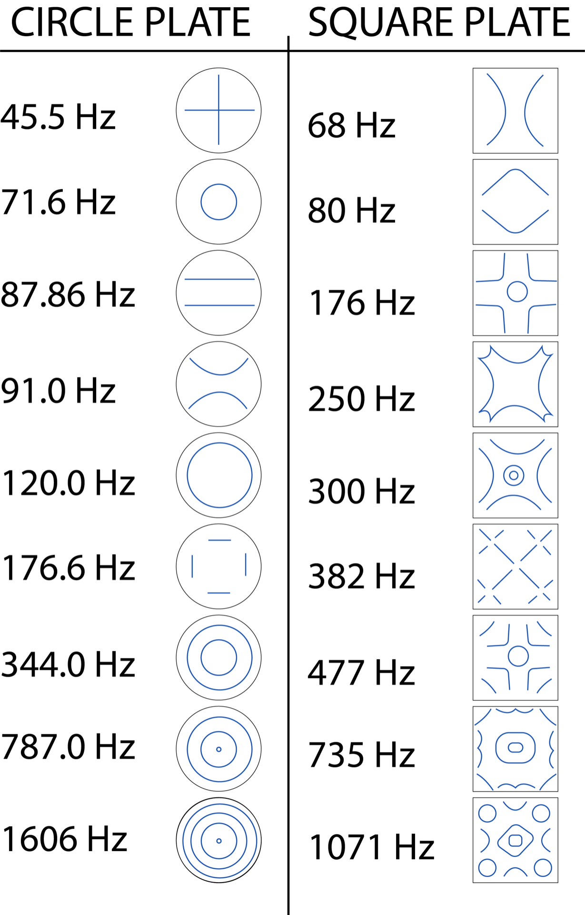
https://www.youtube.com/watch?v=wvJAgrUBF4w
https://ucscphysicsdemo.sites.ucsc.edu/physics-5b6b-demos/oscillations-and-waves/chladni-figures/
Notes:
Of course you can get way more patterns using power of modern tech with function generator, speaker.
Show more complex figures and notice the symmetry.

Slide 24
https://www.youtube.com/watch?v=17tqXgvCN0E
Notes:
Example of object vibrating noticeably in right frequency. Stress the fact that resonance cause them to vibrate in greater amplitudes than normal.
Also note there is not hands on mean of vibration. It is sound

Slide 25
https://www.youtube.com/watch?v=XggxeuFDaDU
Notes:
Example of collapse of Tacoma Bridge (1940)
Example of object vibrating noticeably in right frequency. Stress the fact that resonance cause them to vibrate in greater amplitudes than normal. Even with 50Km wind this much damage can be done when not careful.
Also note there is not hands on mean of vibration.

Slide 26
Chladni Figure For guitar
[6]
https://en.wikipedia.org/wiki/Ernst_Chladni
Notes:
Resonance is not just good for destruction. In music it helps instruments to play louder at particular frequency.
Example here is guitar and some of the patterns it can form.

Slide 27
https://www.slideshare.net/mmarty/resonance-and-natural-frequency-uses-and-precautions-nis
Notes:
Last example is radio signal. When you match the frequency of current in radio to incoming radio, it amplify and you can hear the transmission… If they still use radio, maybe in a car.

